Slide 1
New Report - RU FA 140 Movable Equipment Report April 2020

Slide 2
New Report - RU FA 140 Movable Equipment Report
Report
RU FA 140 will provide important information about a department’s assets such as:
original in-service date
cost of the asset
location of an asset
useful life in years
Departments can run their own reports. This was not available in the past.
Up-to-date list of movable equipment per department.
Budget Preparation
This report could help determine when an asset might need to be replaced.
Departments are the sole custodian of the movable equipment, this report could help departments safeguard University Assets.

Slide 3
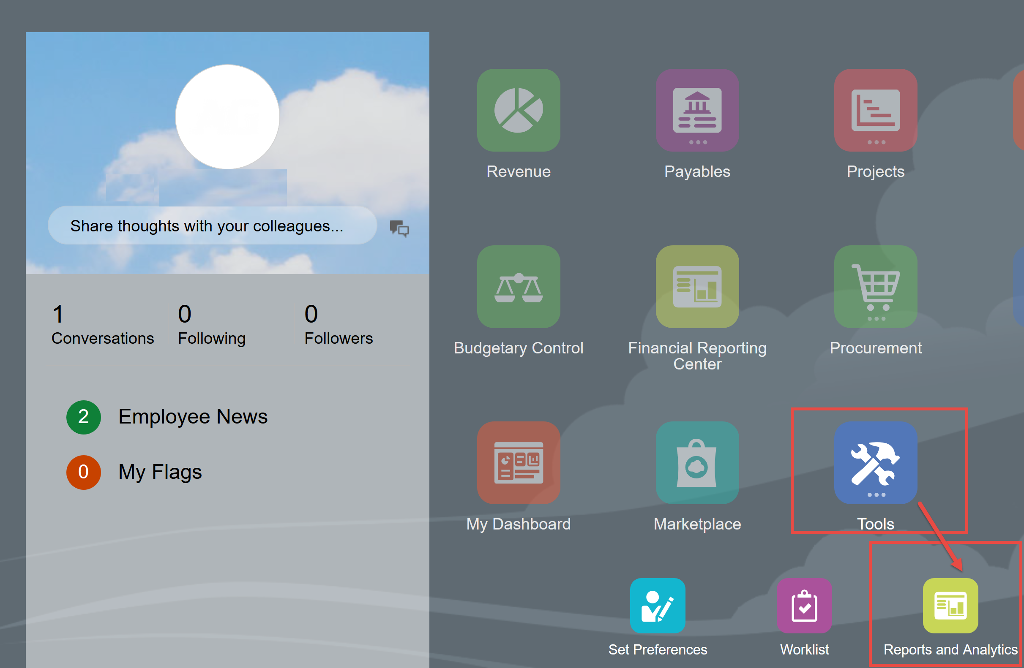
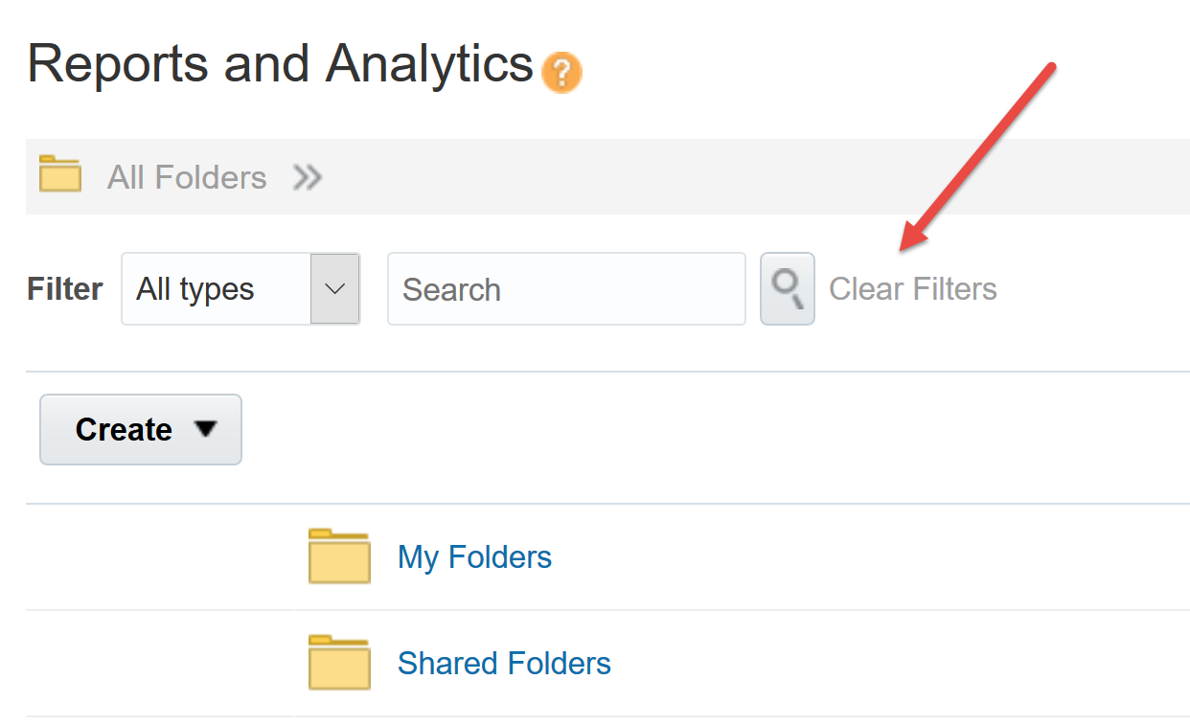
Navigation
Click Tools -> Reports and Analytics Then click clear filters to browse folders

Slide 4
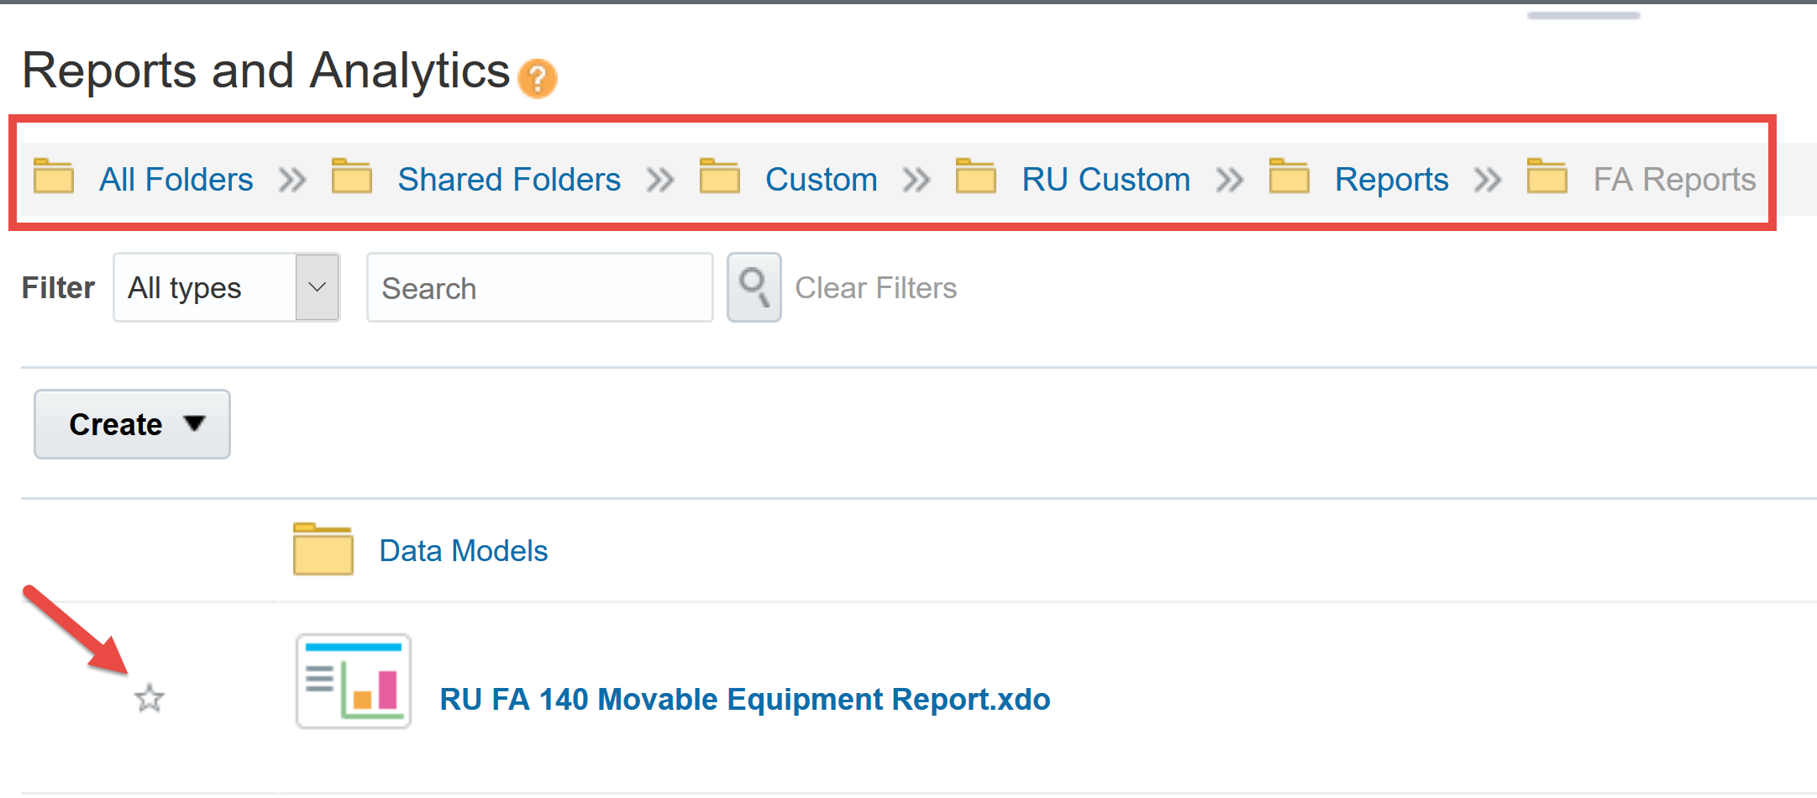
Navigation
Browse to Shared Folders -> Custom -> RU Custom -> Reports ->FA Reports-> RU FA 140 Movable Equipment Report
(Note: You can make this a favorite by clicking the star icon)

Slide 5
Report
When you open the report you will be presented with parameters which can be selected. After making your parameter selections, click the Apply button.

Slide 6
Parameters
Report
Unit; Division;Organization (UDO)
Enter “All” or a “combination of a UDO” in this parameter. Please note the report will not show the actual UDO used when purchasing the moveable equipment but rather a grouping of major departments (UDOs) for Property Management’s audit purposes. The complete listing of UDOs will not be available for running this report, just the audit groupings.
A complete listing of Property Management’s major department groupings can be found on University Accounting’s website.

Slide 7
Parameters
Building Number
Rutgers Building Number represents number assigned to each building.
Audit Group
The audit group represent a logical hierarchy used for grouping multiple related UDO's for audit purpose.
Report

Slide 8
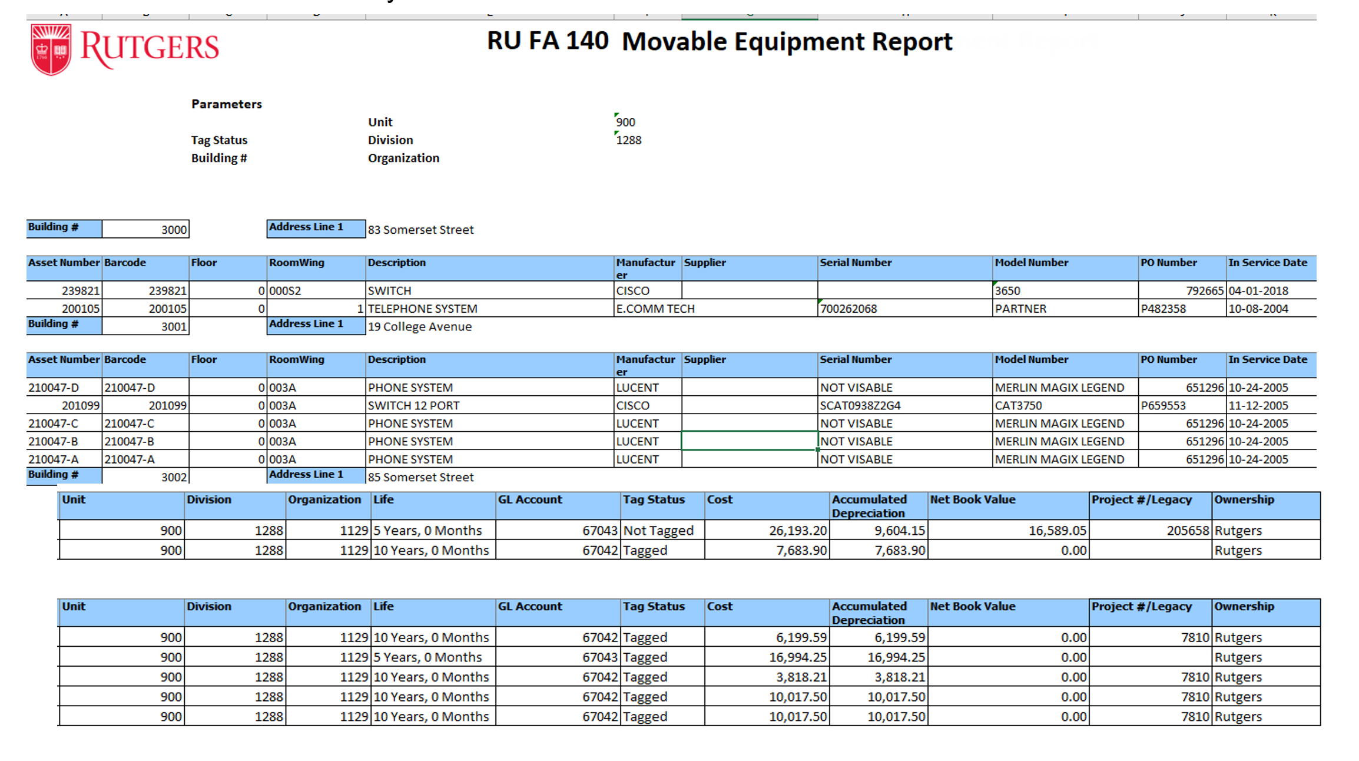
New Report - RU FA 140 Moveable Equipment Report
Report

